Slide 1
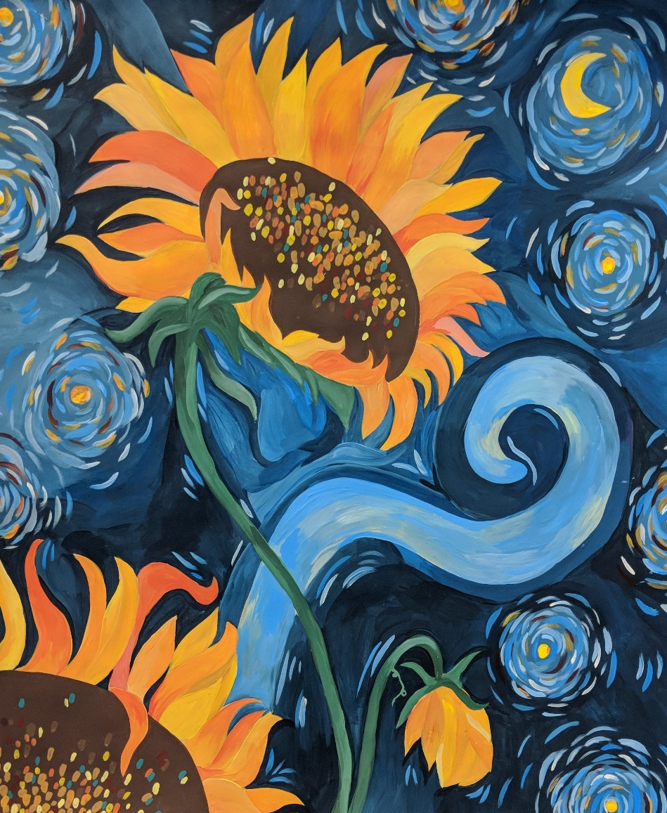
2018-19 Second Interim
March 12, 2019
Board Meeting
Gina Haddadin
8th Grade, Mrs. Lents class
Hans Christensen Middle School

Slide 2

2018-19 Second Interim
Requirements
Education Code (EC) Sections 42130 and 42131 require a school district to submit two financial reports to its governing board during the fiscal year
The 2018-19 Second Interim Financial Report for the period ending January 31, 2019, is due to the Riverside County Office of Education (RCOE) by March 15, 2019
Certification of Financial Condition
  Positive Certification: able to meet financial obligations for the current and subsequent two fiscal years
Multi-year Projections and Assumptions
Riverside County Office of Education Guidance and School Services of California Projections and Assumptions

Slide 3
2018-19 Second Interim
Fiscal Challenges
Operating cost increasing
  STRS/PERS
  Special Education

Slide 4
2018-19 Second Interim
Revenue Assumptions
Factor | 2018-19 |  |  |  | 2019-20 |  |  |  | 2020-21
Funded ADA | 10,005.51 |  |  |  | 10,304.79 |  |  |  | 10,613.16
Cost of Living Adjustment | 3.70% |  |  |  | 3.46% |  |  |  | 2.86%
LCFF Gap Funding | 100% |  |  |  | 100% |  |  |  | 100%
Base Grant per ADA | TK-3 | 4-6 |  | 7-8 | TK-3 | 4-6 |  | 7-8 | TK-3 | 4-6 |  | 7-8
 | $7,459 | $7,571 |  | $7,796 | $7,717 | $7,833 |  | $8,066 | $7,938 | $8,057 |  | $8,297
Grade Span Adjustment (TK-3) | $776 per ADA |  | 3,580,697 |  | $803 per ADA |  | 3,825,901 |  | $826 per ADA |  | 4,053,298
Supplemental Grant | 7,502,295 |  |  |  | 8,037,159 |  |  |  | 8,416,161
Lottery – Unrestricted | $151 per ADA |  | 1,535,232 |  | $151 per ADA |  | 1,578,003 |  | $151 per ADA |  | 1,625,204
Lottery – Restricted | $53 per ADA |  | 538,856 |  | $53 per ADA |  | 553,869 |  | $53 per ADA |  | 570,436
Mandate Block Grant | $31.16 per ADA |  | 303,193 |  | $31.96 per ADA |  | 319,776 |  | $32.81 per ADA |  | 338,100
Routine Restricted Maintenance | 3,063,061 |  |  |  | 3,264,622 |  |  |  | 3,384,343
  Routine Restricted Maintenance (RRMA) Contribution - $2,268,357
  Lottery - $140 per ADA (Unrestricted) and $41 per ADA (Restricted)

Slide 5
2018-19 Second Interim
Expenditure Assumptions
  Increase in staffing due to enrollment growth
  Step and Column movement at 1.5%
  Statutory Fringe Benefits – as required by RCOE
  STRS and PERS as per current estimates
 | 2018-19 |  | 2019-20 |  | 2020-21
CalSTRS | 16.28% | 7,794,213 | 17.10% | 8,191,422 | 18.10% | 8,695,721
CalPERS | 18.06% | 2,268,615 | 20.70% | 2,652,202 | 23.40% | 3,064,190
Total Estimated STRS and PERS | 10,062,828 |  | 10,843,624 |  | 11,759,911
Estimated Annual Increase | 1,797,259 |  | 780,796 |  | 916,287

Slide 6
2018-19 Second Interim
Revenue
 | 2018-19 | 2019-20 | 2020-21
LCFF/Revenue Limit Sources | 87,048,495 | 92,789,614 | 98,188,252
Federal Revenues | 4,295,101 | 3,762,924 | 3,762,924
Other State Revenues | 9,817,058 | 6,967,864 | 7,049,955
Other Local Revenues | 5,208,138 | 5,189,088 | 5,189,088
Transfers In | 45,000 | 45,000 | 45,000
Total Revenues | 106,413,792 | 108,754,490 | 114,235,219

Slide 7
2018-19 Second Interim
Expense
 | 2018-19 | 2019-20 | 2020-21
Certificated Salaries | 48,440,143 | 50,429,851 | 52,698,367
Classified Salaries | 14,540,826 | 15,258,829 | 15,588,040
Employee Benefits | 24,791,864 | 26,530,010 | 28,261,569
Books and Supplies | 5,118,161 | 4,229,352 | 4,000,853
Services and Other Operating Expense | 11,299,654 | 10,539,436 | 10,527,575
Capital Outlay | 344,130 | 125,663 | 112,142
Other Outgo | 1,799,959 | 1,707,589 | 1,622,877
TOTAL | 106,334,737 | 108,820,730 | 112,811,423

Slide 8
2018-19 Second Interim
MYP and Reserves
Current | 2017-18 | 2018-19 | 2019-20 | 2020-21
Beginning Fund Balance | 9,433,422 | 8,253,187 | 8,332,241 | 8,266,001
Net Change In Fund Balance | (1,180,235) | 79,054 | (66,241) | 1,423,796
Ending Fund Balance | 8,253,187 | 8,332,241 | 8,266,001 | 9,689,797
Non-spendable | 5,000 | 5,000 | 5,000 | 5,000
Restricted | 1,504,721 | 1,574,091 | 2,204,006 | 3,082,190
3% Required Reserve | 2,959,012 | 3,190,042 | 3,264,622 | 3,384,343
Budget Contingency | 3,784,454 | 3,563,108 | 2,792,373 | 3,218,264
Total Available Reserve | 6.84% | 6.35% | 5.57% | 5.85%

Slide 9
Questions / Comments
Thank You!
Gina Haddadin
8th Grade, Mrs. Lents class
Hans Christensen Middle School

