Slide 1
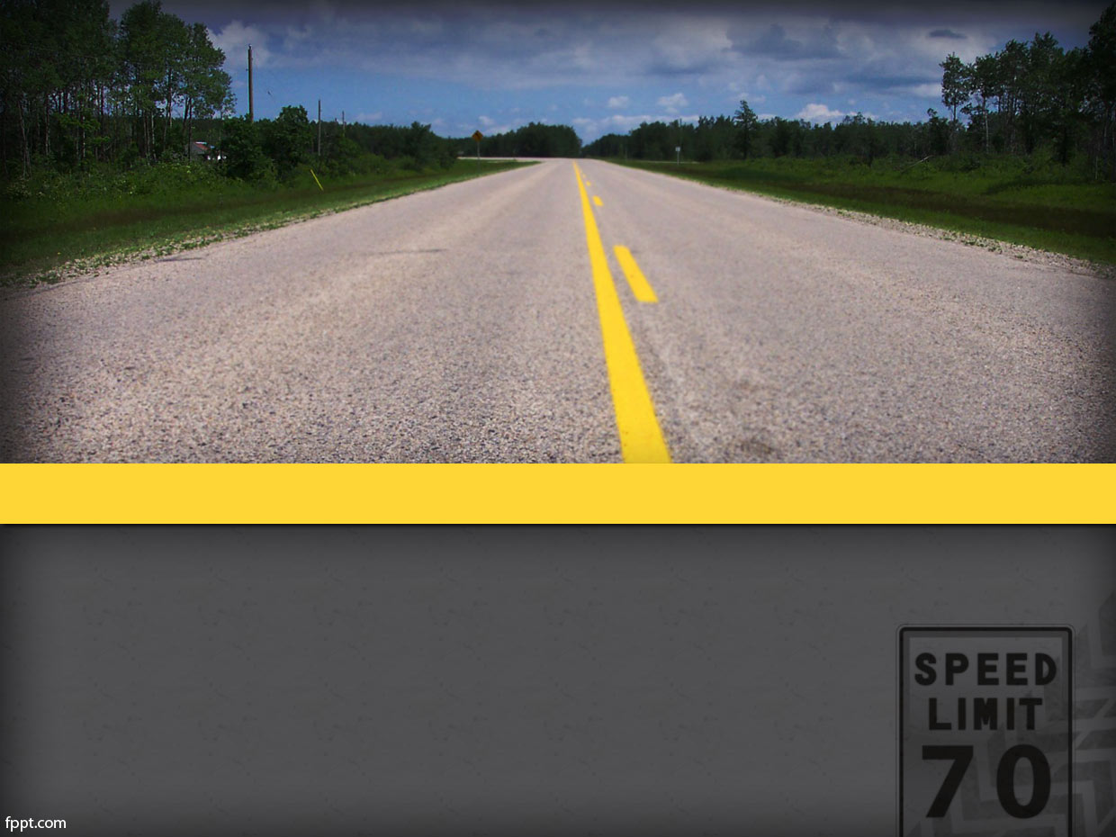

Board Study Session: Student Transportation
October 22, 2019

Slide 2
Transportation Funding
Historically there has been significant shortcomings with the state’s funding of student transportation
Local Control Funding Formula (based on 12-13 Home-to-School Transportation)
  Flat funding amount of $138,150
Federal law requires school districts to provide transportation to certain students
  Students with disabilities
  Homeless students

Slide 3
Transportation
MYP Estimated Impact
Total Increase $177,322
Current 2019/20
Current – 2020/21
Current – 2021/22
MS
EL
SPED – Routes (13)
GenEd – Routes (0)
Estimated Cost $1,450,640
MS
EL
SPED – Routes (14)
GenEd – Routes (0)
Estimated Cost $1,536,745
MS
EL
SPED – Routes (15)
GenEd – Routes (0)
Estimated Cost $1,627,962
Increase of $86,105
Increase of $91,217

Slide 4
Transportation
Funding and Expense
Fiscal Year | State Revenue | Other Revenue | Total Revenue | Special Ed Expense* | General Ed Expense | Total Expense | Deficit
18-19 | $138,150 | $0 | $138,150 | $1,618,066 | $0 | $1,618,066 | $1,479,916
17-18 | $138,150 | $0 | $138,150 | $1,503,194 | $0 | $1,503,194 | $1,365,044
16-17 | $138,150 | $0 | $138,150 | $805,460 | $1,338,728 | $2,144,188 | $2,006,038
15-16 | $138,150 | $156,290 | $267,537 | $760,631 | $912,938 | $1,673,569 | $1,406,032
14-15 | $138,150 | $153,442 | $291,592 | $737,190 | $813,893 | $1,551,083 | $1,259,491
13-14 | $138,150 | $198,881 | $337,031 | $561,151 | $598,764 | $1,159,915 | $961,034
12-13 | $138,150 | $163,014 | $301,164 | $677,871 | $496,949 | $1,174,820 | $873,656
11-12 | $138,419 | $180,690 | $319,109 | $733,574 | $610,532 | $1,344,106 | $1,024,997
10-11 | $135,059 | $194,542 | $329,601 | $617,034 | $696,575 | $1,313,609 | $984,008
09-10 | $134,635 | $210,934 | $345,569 | $642,041 | $804,272 | $1,446,313 | $1,100,744
08-09 | $167,961 | $210,020 | $377,981 | $670,543 | $841,374 | $1,511,917 | $1,133,936
* Only includes cost of SPED students on SPED specific buses

Slide 5
Transportation
Historical Ridership
Fiscal Year | Gen Ed Riders | SPED Riders | Total Ridership | Gen Ed Estimated Routes | SPED Estimated Routes | Total Estimated Routes
18-19 | 0 | 135 | 135 | 0 | 14 | 14
17-18 | 0 | 134 | 134 | 0 | 13 | 13
16-17 | 1,451 | 132 | 1,583 | 26 | 13 | 39
15-16 | 901 | 110 | 1,011 | 16 | 11 | 27
14-15 | 767* | 103* | 870 | 14 | 10 | 24
13-14 | 950* | 128* | 1,078 | 17 | 13 | 30
12-13 | 902 | 127 | 1,029 | 16 | 13 | 29
11-12 | 1,383 | 115 | 1,498 | 25 | 12 | 37
10-11 | 1,386 | 171 | 1,557 | 25 | 17 | 42
09-10 | 1,377 | 172 | 1,549 | 25 | 17 | 42
08-09 | 1,010 | 152 | 1,162 | 18 | 15 | 33
* Estimated based on historical data and total ridership

Slide 6
Transportation
Fictitious Scenarios
Staff was asked to create a fictitious scenario in which home-to-school transportation was offered to all students for a fee.
Scenario One
  Assumed fee → $1,000
  Assumed ridership ranging from 1,481 to 1,559 students
  Assumptions based upon historical data
Scenario Two
  Assumed fee → $500
  Assumed ridership ranging from 1,481 to 1,559 students
  Assumptions based upon historical data
Scenario Three
  Assumed fee → $500
  Assumed ridership for middle school students only
  Assumptions based upon historical data

Slide 7
Transportation
Fictitious Scenario Once
Scenario One
  Assumed fee → $1,000
  Assumed ridership ranging from 1,481 to 1,559 students
  Assumptions based upon historical data
  Total Routes ranging from 38 to 41
    Additional 24 big buses
    Additional 24 drivers
    Additional 2 mechanics
    Additional 2 office staff
    Additional Transportation Director
  Transportation yard updated

Slide 8
Transportation Fees
Fictitious Scenario One
Fiscal Year | Gen Ed Estimated Ridership | SPED Estimated Ridership | Total Estimated Ridership | Proposed Fee Charged Gen Ed Rider
23-24 | 1,428 | 171 | 1,599 | $1,000
22-23 | 1,397 | 162 | 1,559 | $1,000
21-22 | 1,367 | 153 | 1,519 | $1,000
20-21 | 1,337 | 144 | 1,481 | $1,000
School District | 2019-20 Gen Ed Ridership Fee
Menifee | $1,000
Lake Elsinore | $300
Temecula | $550

Slide 9
Fictitious Scenario One
MYP Estimated Impact
Total Increase $1,542,971
Current 2019/20
FS One – 2020/21
FS One – 2021/22
MS
EL
SPED – Routes (13)
GenEd – Routes (0)
Estimated Cost $1,450,640
MS 2.5 Crow Flight
EL 1.0 Crow Flight
SPED – Routes (14)
GenEd – Routes (24)
Estimated Cost $2,872,817
MS 2.5 Crow Flight
EL 1.0 Crow Flight
SPED – Routes (15)
GenEd – Routes (24)
Estimated Cost $2,993,611
Increase of $1,422,177
Increase of $120,794

Slide 10
Transportation
Funding and Expense
Fictitious Scenario One
Fiscal Year | State Revenue | Other Revenue** | Total Revenue | Special Ed Expense* | General Ed Expense | Total Expense | Deficit
23-24 | $138,150 | $1,426,783 | $1,564,933 | $1,826,959 | $1,426,783 | $3,253,742 | $1,688,809
22-23 | $138,150 | $1,395,881 | $1,534,031 | $1,724,593 | $1,395,881 | $3,120,474 | $1,586,443
21-22 | $138,150 | $1,365,649 | $1,503,799 | $1,627,962 | $1,365,649 | $2,993,611 | $1,489,812
20-21 | $138,150 | $1,336,071 | $1,474,221 | $1,536,745 | $1,336,071 | $2,872,817 | $1,398,595
19-20 | $138,150 | $0 | $138,150 | $1,450,640 | $0 | $1,450,640 | $1,312,490
Note:
* Only Includes cost of SPED students on SPED specific buses
**Other Revenue Assumptions include an average transportation fee of $1,000 per rider for each year in 2020-21 and beyond. This calculation does not include the cost for those students who would be deemed eligible to ride for free based on income eligibility.

Slide 11
Transportation Facilities Needs
Fictitious Scenario One
Upgrade Transportation Yard → $20,000,000
Additional Staffing → $ 1,336,071 per year
  Mechanic
  Bus Drivers
  Office Staff
  Director
Additions to Fleet → $ 7,200,000
Other Revenue Assumptions would cover cost of additional staff but would not cover cost for Capital Upgrades (Yard and Fleet).
  We would need to identify a funding source
    Another local bond
    Financing options

Slide 12
Transportation
Fictitious Scenario Two
Scenario Two
  Assumed fee → $500
  Assumed ridership ranging from 1,481 to 1,559 students
  Assumptions based upon historical data
  Total Routes ranging from 38 to 41
    Additional 24 big buses
    Additional 24 drivers
    Additional 2 mechanics
    Additional 2 office staff
    Additional Transportation Director
  Transportation yard updated

Slide 13
Transportation Fees
Fictitious Scenario Two
Fiscal Year | Gen Ed Estimated Ridership | SPED Estimated Ridership | Total Estimated Ridership | Proposed Fee Charged Gen Ed Rider
23-24 | 1,428 | 171 | 1,599 | $500
22-23 | 1,397 | 162 | 1,559 | $500
21-22 | 1,367 | 153 | 1,519 | $500
20-21 | 1,337 | 144 | 1,481 | $500
School District | 2019-20 Gen Ed Ridership Fee
Menifee | $500
Lake Elsinore | $300
Temecula | $550

Slide 14
Fictitious Scenario Two
MYP Estimated Impact
Total Increase $1,542,971
Current 2019/20
FS Two – 2020/21
FS Two – 2021/22
MS
EL
SPED – Routes (13)
GenEd – Routes (0)
Estimated Cost $1,450,640
MS 2.5 Crow Flight
EL 1.0 Crow Flight
SPED – Routes (14)
GenEd – Routes (24)
Estimated Cost $2,872,817
MS 2.5 Crow Flight
EL 1.0 Crow Flight
SPED – Routes (15)
GenEd – Routes (24)
Estimated Cost $2,993,611
Increase of $1,422,177
Increase of $120,794

Slide 15
Transportation
Funding and Expense
Fictitious Scenario Two
Fiscal Year | State Revenue | Other Revenue** | Total Revenue | Scenario One Deficit | Scenario Two Deficit | Increase in Deficit
23-24 | $138,150 | $713,983 | $852,133 | $1,688,809 | $2,401,610 | $712,800
22-23 | $138,150 | $698,519 | $836,669 | $1,586,443 | $2,283,805 | $697,363
21-22 | $138,150 | $683,390 | $821,540 | $1,489,812 | $2,172,071 | $682,259
20-21 | $138,150 | $668,589 | $806,739 | $1,398,595 | $2,066,078 | $667,482
Note:
* Only Includes cost of SPED students on SPED specific buses
**Other Revenue Assumptions include an average transportation fee of $500 per rider for each year in 2020-21 and beyond. This calculation does not include the cost for those students who would be deemed eligible to ride for free based on income eligibility.

Slide 16
Transportation Facilities Needs
Fictitious Scenario Two
Upgrade Transportation Yard → $20,000,000
Additional Staffing → $ 1,336,071 per year
  Mechanic
  Bus Drivers
  Office Staff
  Director
Additions to Fleet → $ 7,200,000
Other Revenue Assumptions would cover cost of additional staff but would not cover cost for Capital Upgrades (Yard and Fleet).
  We would need to identify a funding source
    Another local bond
    Financing options

Slide 17
Transportation
Fictitious Scenario Three
Scenario Three
  Assumed fee → $500
  Assumed ridership for middle school students only
  Assumptions based upon historical data
  Total Routes ranging from 29 to 37
    Additional 20 big buses
    Additional 20 drivers
    Additional 2 mechanics
    Additional 2 office staff
    Additional Transportation Director
  Transportation yard updated

Slide 18
Fictitious Scenario Three
MYP Estimated Impact
Total Increase $993,426
Current 2019/20
FS One – 2020/21
FS One – 2021/22
MS
EL
SPED – Routes (13)
GenEd – Routes (0)
Estimated Cost $1,450,640
MS 2.5 Crow Flight
EL 1.0 Crow Flight
SPED – Routes (14)
GenEd – Routes (15)
Estimated Cost $2,373,231
MS 2.5 Crow Flight
EL 1.0 Crow Flight
SPED – Routes (15)
GenEd – Routes (15)
Estimated Cost $2,444,066
Increase of $922,591
Increase of $70,835

Slide 19
Transportation
Funding and Expense
Fictitious Scenario Three
Fiscal Year | State Revenue | Other Revenue** | Total Revenue | Special Ed Expense* | General Ed Expense | Total Expense | Deficit
23-24 | $138,150 | $563,983 | $702,132 | $1,826,959 | $1,127,031 | $2,953,990 | $2,251,858
22-23 | $138,150 | $423,519 | $561,669 | $1,724,593 | $846,337 | $2,570,929 | $2,009,260
21-22 | $138,150 | $408,390 | $546,540 | $1,627,962 | $816,104 | $2,444,066 | $1,897,526
20-21 | $138,150 | $418,589 | $556,739 | $1,536,745 | $836,485 | $2,373,231 | $1,816,492
19-20 | $138,150 | $0 | $138,150 | $1,450,640 | $0 | $1,450,640 | $1,312,490
Note:
* Only Includes cost of SPED students on SPED specific buses
**Other Revenue Assumptions include an average transportation fee of $500 per rider for each year in 2020-21 and beyond. This calculation does not include the cost for those students who would be deemed eligible to ride for free based on income eligibility.

Slide 20
Transportation
Funding and Expense
Fictitious Scenarios
Fiscal Year | Scenario One Deficit | Scenario Two Deficit | Scenario Three Deficit | Increase in Deficit (One vs Three)
23-24 | $1,688,809 | $2,401,610 | $2,251,858 | $563,049
22-23 | $1,586,443 | $2,283,805 | $2,009,260 | $422,818
21-22 | $1,489,812 | $2,172,071 | $1,897,526 | $407,714
20-21 | $1,398,595 | $2,066,078 | $1,816,492 | $417,896
Note:
* Only Includes cost of SPED students on SPED specific buses
**Other Revenue Assumptions include an average transportation fee of $500 per rider for each year in 2020-21 and beyond. This calculation does not include the cost for those students who would be deemed eligible to ride for free based on income eligibility.

Slide 21
Transportation Facilities Needs
Fictitious Scenario Three
Upgrade Transportation Yard → $20,000,000
Additional Staffing → $ 1,049,457 per year
  Mechanic
  Bus Drivers
  Office Staff
  Director
Additions to Fleet → $ 6,000,000
Other Revenue Assumptions would cover cost of additional staff but would not cover cost for Capital Upgrades (Yard and Fleet).
  We would need to identify a funding source
    Another local bond
    Financing options

Slide 22
Questions / Comments

