Slide 1


Slide 2

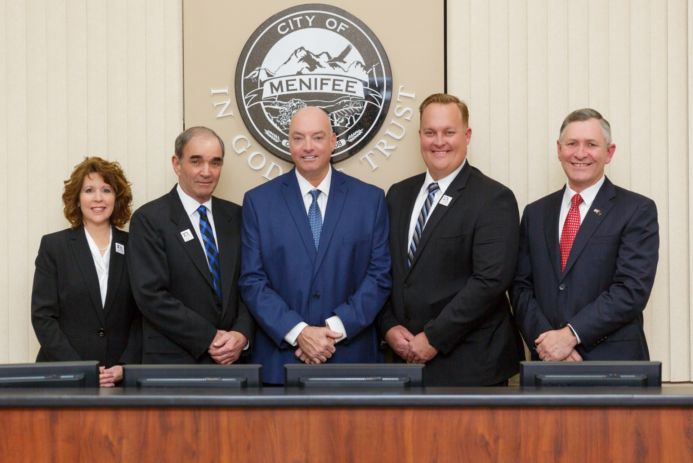
MENIFEE
CITY COUNCIL
Lesa Sobek
Councilmember
3rd District
Greg August
Mayor Pro Tem
1st District
Bill Zimmerman
Mayor
Matt Liesemeyer
Councilmember
2nd District
Dean Deines
Councilmember
4th District

Slide 3

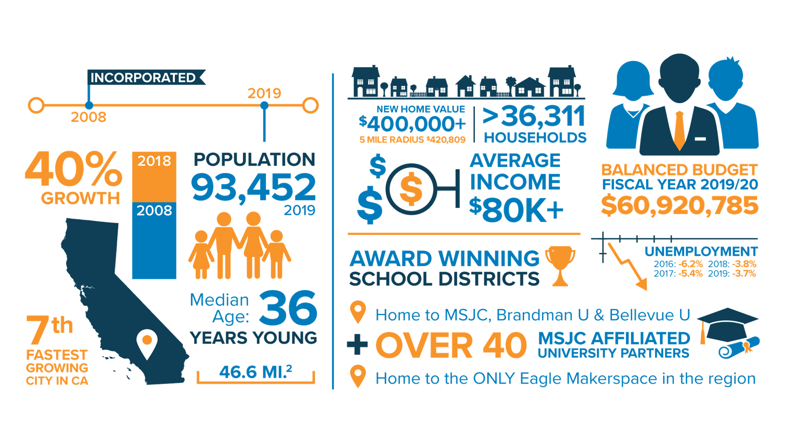

Slide 4

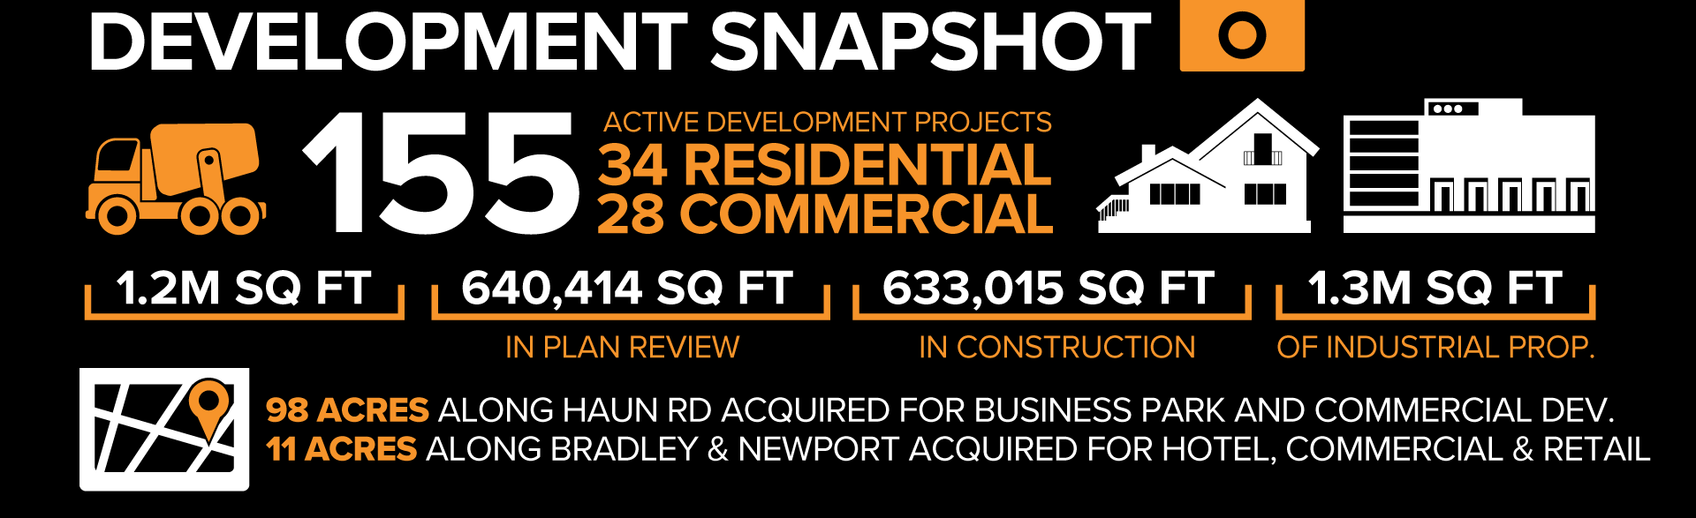

Slide 5

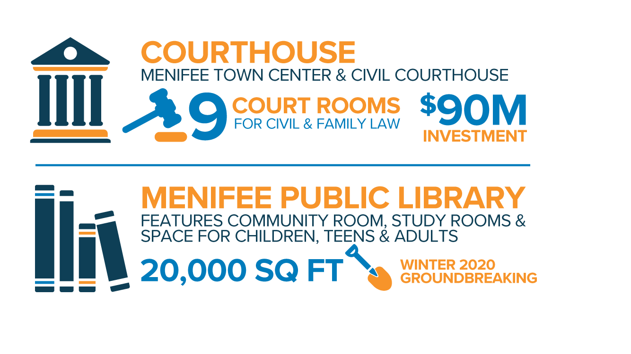
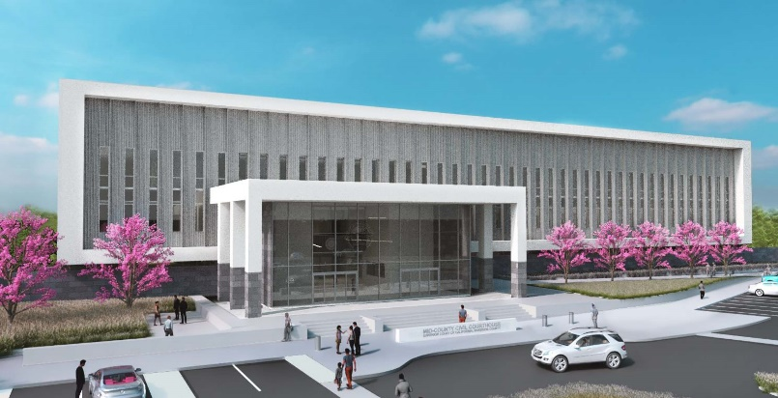
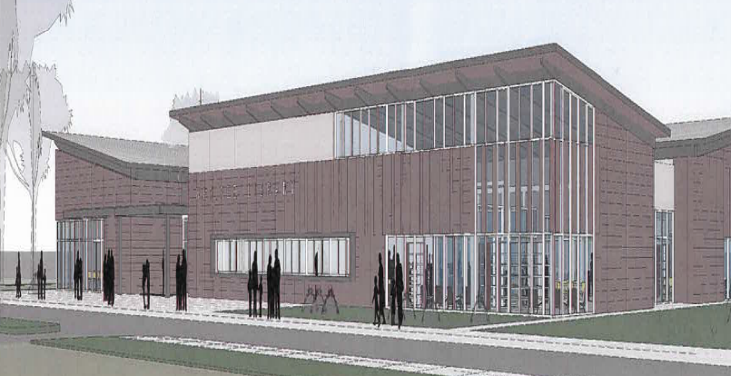
COURTHOUSE & LIBRARY

Slide 6

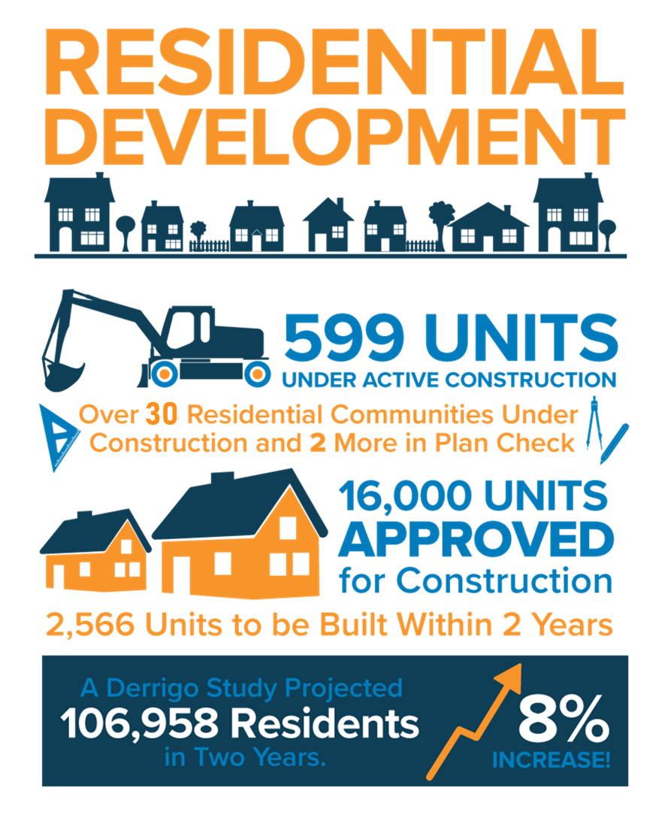

Slide 7

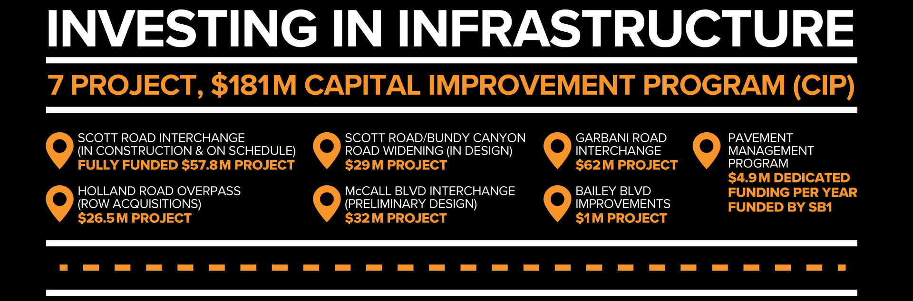

Slide 8


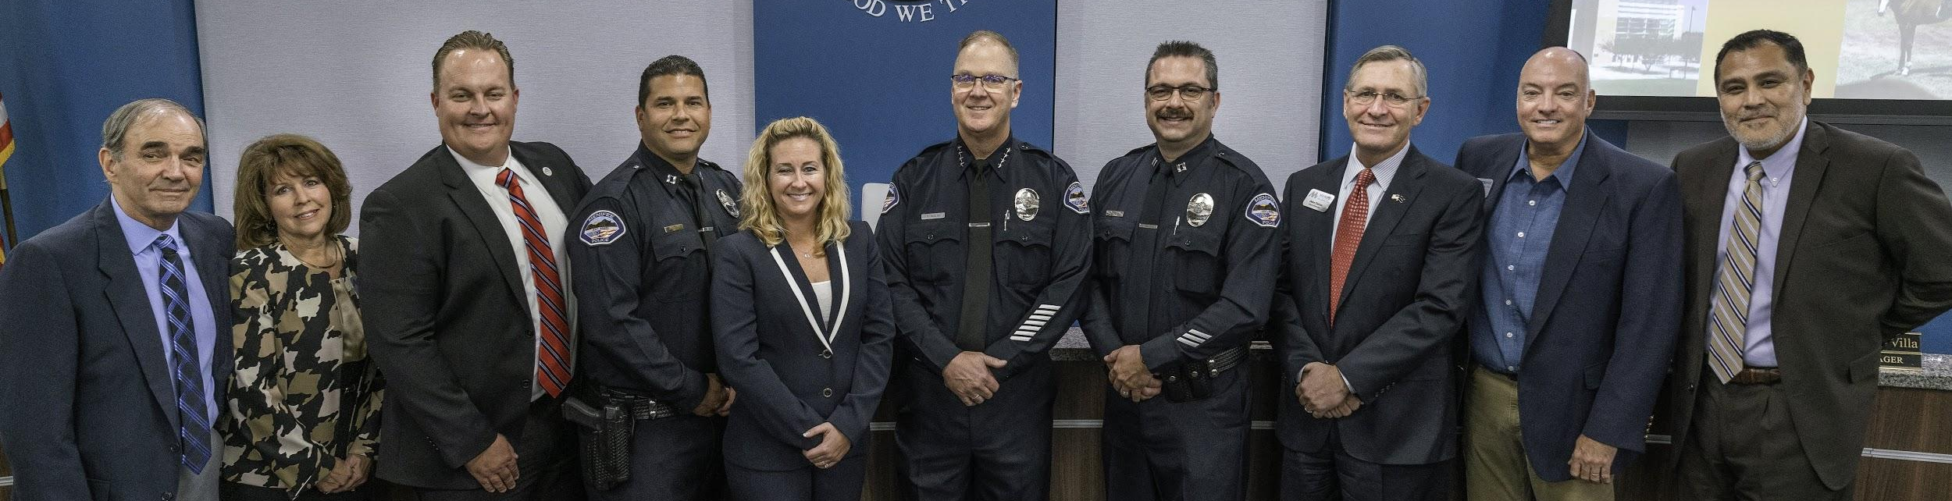


Slide 9
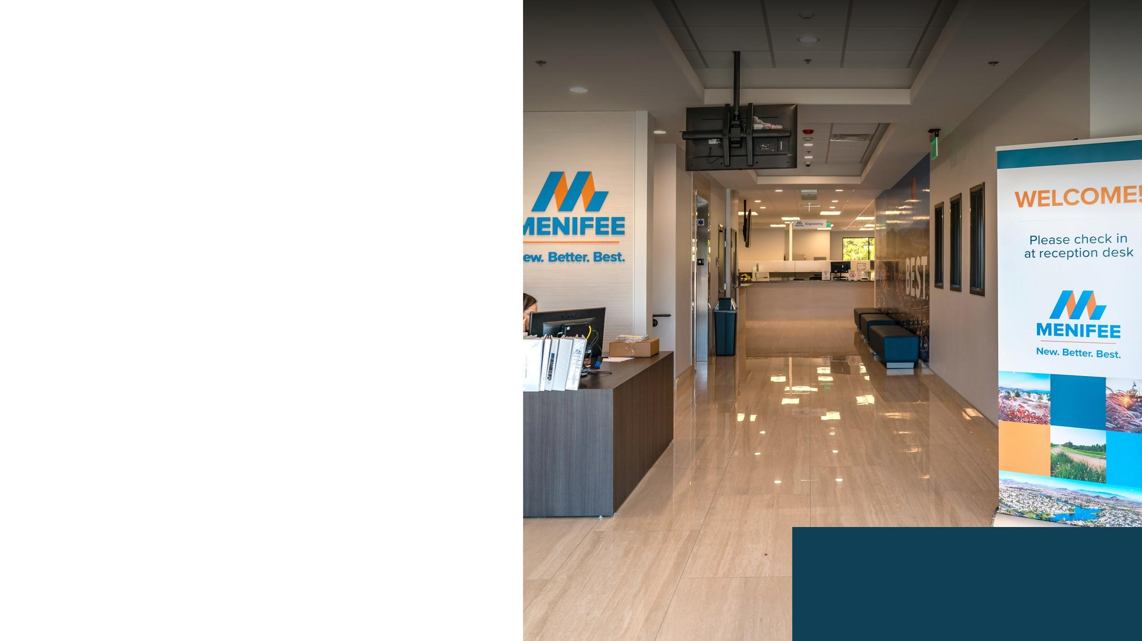
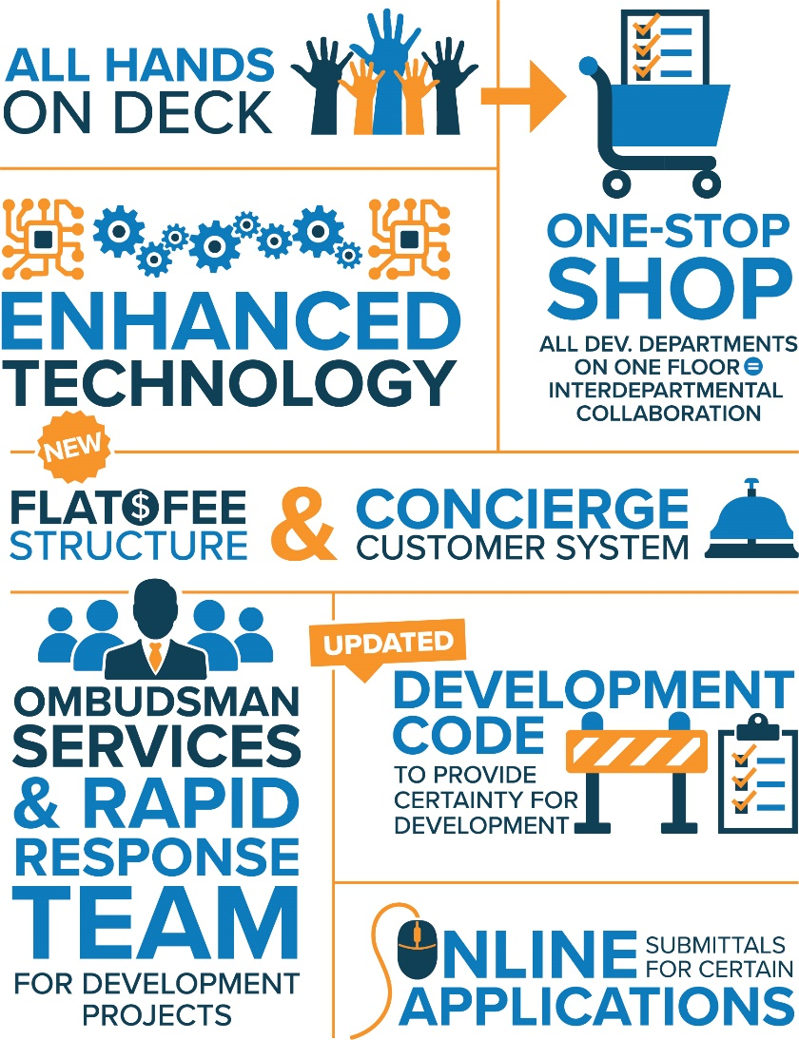

INVESTING IN
CUSTOMER SERVICE
Streamline Menifee Initiative
New City Hall Location/Space
Added 51 new employees this past year alone!
Implemented new & innovative technology

Slide 10

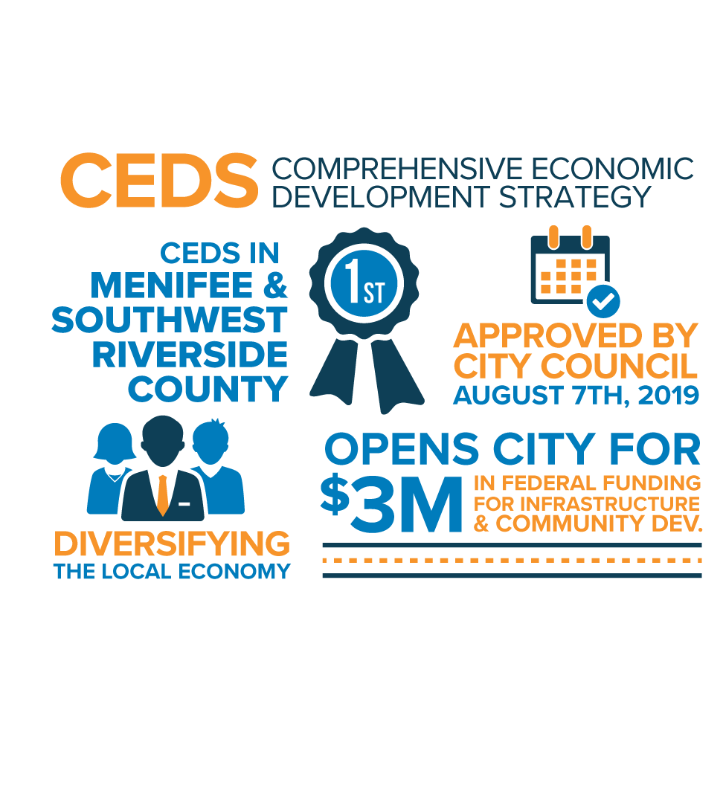
WE ARE INVESTING IN JOB CREATION
TARGETED INDUSTRIES
Food & Beverage Manufacturing
Regional Healthcare firms & Facilities
Continuing Care/Assisted Living
Advanced Manufacturing
Distilleries
Logistic Technology/Robotics
Data Centers/Research & Development
Computer Systems Design
Architect & Engineering Services
Aviation/ Navigational, Measuring & Control Instruments Manufacturing
BioTech/Life Science
Defense Contractors

Slide 11





AWARD-WINNING CITY

Slide 12

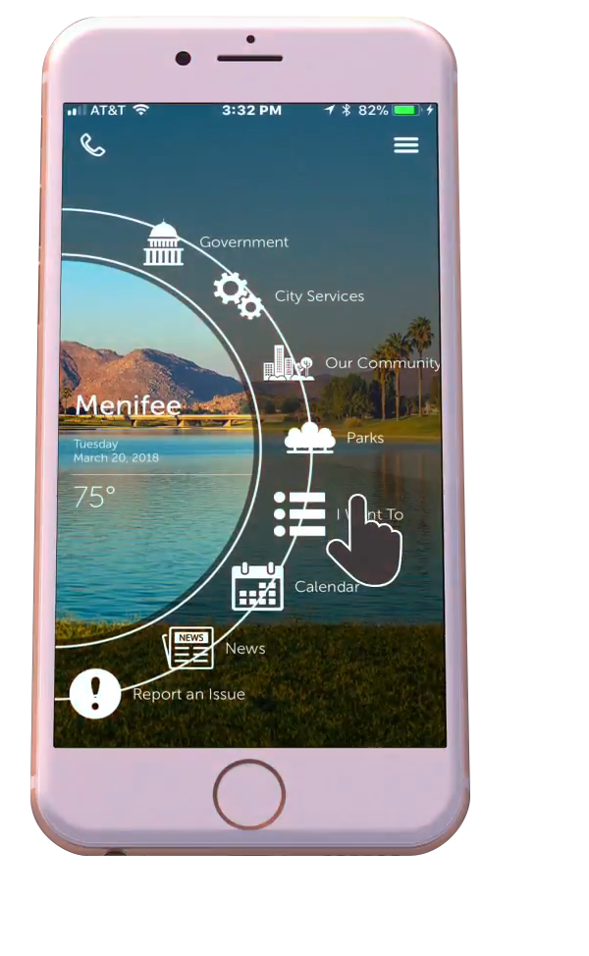


WAYS TO
CONNECT
INTRODUCING
MENIFEE’S OFFICIAL APP
Economic Development E-Newsletter
City wide E-Newsletter
Focus Newsletter
Menifee Matters
Social Media Platforms
Menifee Pulse Podcast
  every Thursday after City Council Meetings
Menifee Mobile App
Menifee Minute
  Facebook Stream
Social Media Platforms:

Slide 13


